Slide 1
CES 361
Fundamentals of Software Testing
Session 11

Slide 2
Part 1. Midterm Exam Review
Pass all midterm exams back
(unless you want to get a zero)

Slide 3
Part 2. HW 3 Returns
Next up? HW 4.

Slide 4
Part 3. Intro to TDD
How many have already written Proj 2 code?
How many of you think you are done coding?

Slide 5
Conventional Development
Reqs
Design
Code
Test
TDD
Reqs
Design
the Test
Code
Test

Slide 6

Let’s talk about TDD
STAGE 1
In test-driven development, each new feature begins with writing a test.
To write a test, the developer must clearly understand the feature's specification and requirements.
The developer can accomplish this through use cases to cover the requirements and exception conditions.
This is a differentiating feature of test-driven development versus writing unit tests after the code is written; it makes the developer focus on the requirements before writing the code, a subtle but important difference.
Question: How does this differ from V-Model development?

Slide 7
Let’s talk about TDD
STAGE 2
Run all tests and see if the new one fails
This validates that the test harness is working correctly, that the new test does not mistakenly pass without requiring any new code, and that the required feature does not already exist.
This step also tests the test itself, in the negative: it rules out the possibility that the new test always passes, and therefore is worthless. The new test should also fail for the expected reason. This step increases the developer's confidence that the unit test is testing the correct constraint, and passes only in intended cases.
Question: What can we infer from all that?

Slide 8
Let’s talk about TDD
STAGE 3
The next step is to write some code that causes the test to pass.
At this point, the only purpose of the written code is to pass the test; no further (and therefore untested) functionality should be predicted nor 'allowed for' at any stage.
Has anyone seen the movie “What about Bob”?

Slide 9
Let’s talk about TDD
STAGE 4
If all test cases now pass, the programmer can be confident that the new code meets the test requirements, and does not break or degrade any existing features.
Question: What caveat would you put on this?

Slide 10
Let’s talk about TDD
STAGE 5
The growing code base must be cleaned up regularly during test-driven development.
Question: Does anyone know the fancy name for this?
Advanced Question: What does “refactoring” tell you about this methodology?

Slide 11
Going back to this…
Conventional Development
Reqs
Design
Code
Test
TDD
Reqs
Design
the Test
Code
Test
What’s not depicted in this oversimplified diagram?

Slide 12
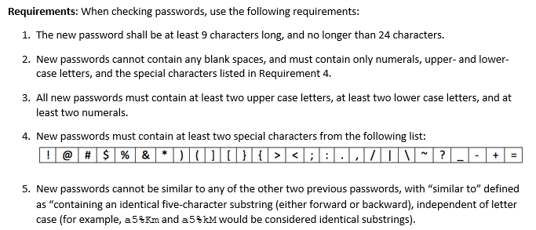
Now, back to one of the first questions I asked you…
How could TDD by applied to a project like this one?

Slide 13
Conventional Development
Reqs
Design
Code
Test
TDD
Reqs
Design
the Test
Code
Test
I’m not going to tell you how to develop your password checker software
However, I urge you to think about how this might turn out differently
if you changed development methodologies

Slide 14
This slide intentionally left blank

